Slide 1
Quadrilaterals
Miss L
Year 7

Slide 2
Learning Intentions
Students will be able to
- Label the different quadrilaterals

Slide 3

Last Lesson Revision
Name the triangle
I have all side and angles equal
I have two side of equal length
All my angles are less than 90°
I have 2 sides of equal length and I have an angle greater than 90°
WICOR
Notes:
Closure/ exit pass

Slide 4
Name the triangle
I have all side and angles equal
Equilateral Triangle
I have two side of equal length
Isosceles Triangle
All my angles are less than 90°
Acute Triangle
I have 2 sides of equal length and I have an angle greater than 90°
Obtuse Isosceles Triangle
Notes:
Closure/ exit pass

Slide 5
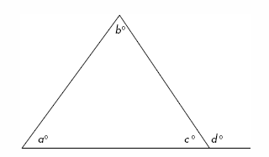
24
7
30
Topic: Quadrilaterals
Date:
EQ – How do we classify quadrilaterals?
From last lesson:
aº + bº + cº = 180º
cº + dº = 180º
aº + bº = dº

Slide 6
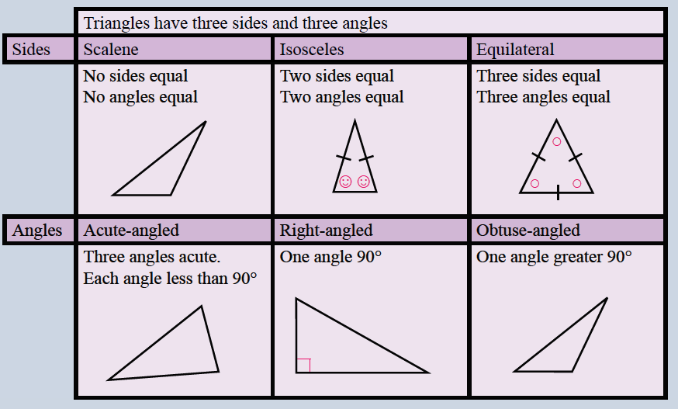

Slide 7

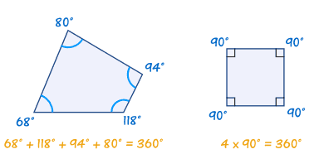
24
7
30
Topic: Quadrilaterals
Date:
EQ – How do we classify quadrilaterals?
What is a quadrilateral?
A quadrilateral has four sides and four angles
All the angles add up to 360°

Slide 8


Slide 9
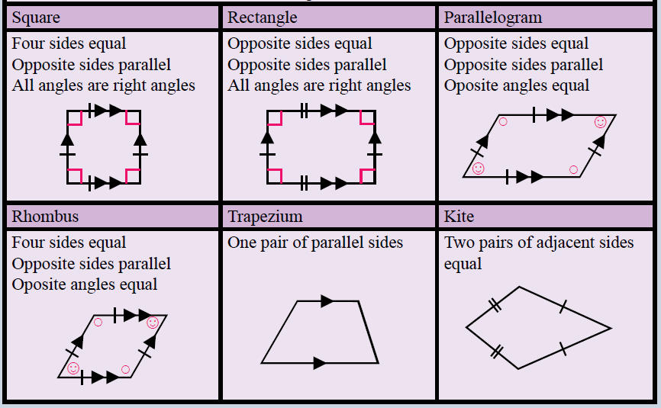
Notes:
Draw a table like the following in your book:

Slide 10
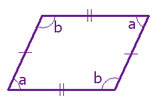
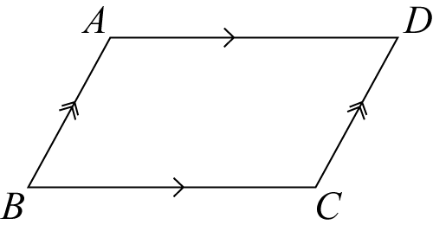
24
7
30
Topic: Quadrilaterals
Date:
EQ – How do we classify quadrilaterals?
Properties of a Parallelogram
Opposite angles are equal
a + b = 180°
Alternate angles formed by diagonal line is the same size

Slide 11
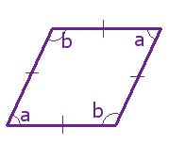
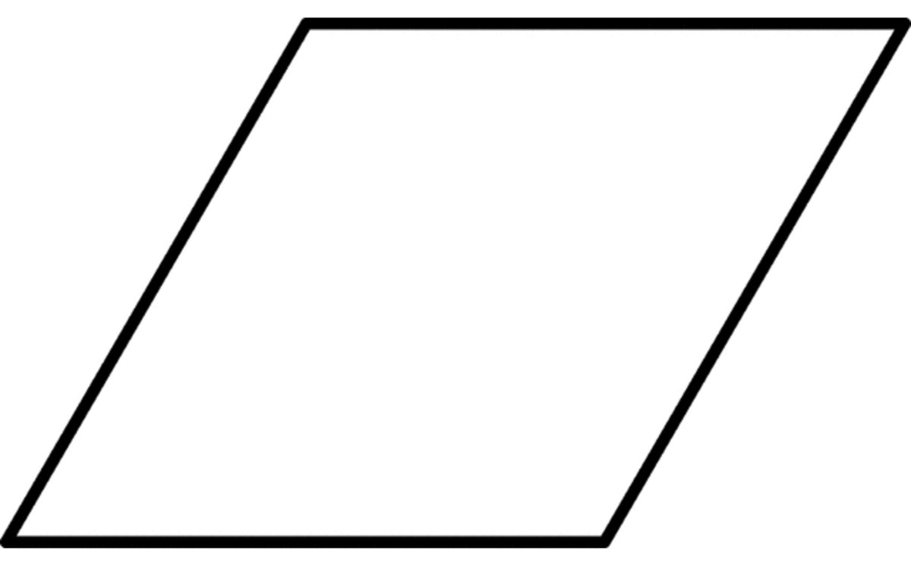
24
7
30
Topic: Quadrilaterals
Date:
EQ – How do we classify quadrilaterals?
Properties of a Rhombus
Opposite angles are equal
a + b = 180°

Slide 12
Practice
1. Complete the worksheet
2. Complete your summary as your exit pass
WICOR

